Slide 1



Emerald International College
Group2 Advanced Data Base Presentation
Submitted to Dr Efrem
EICHRIS
Su
October 2023
Addis Ababa , Ethiopia .

Slide 2

Sample 1
Presentation outline
Introduction
Abstract, Statement of Problems, Objectives , Scopes
PEOPLE • PROCESS • TOOLS • EXPERIENCE
Methodology
Methodology and Tools to Use
Feasibility
Technical Feasibility ,Economic Feasibility ,Operational Feasibility
Management Plan
Team Configuration ,Communication plan and Change mgt plan .
System Design
ER-Diagram , Sequences Diagram .
Implementation Phase
System User Interfaces and Sample Codes

Slide 3

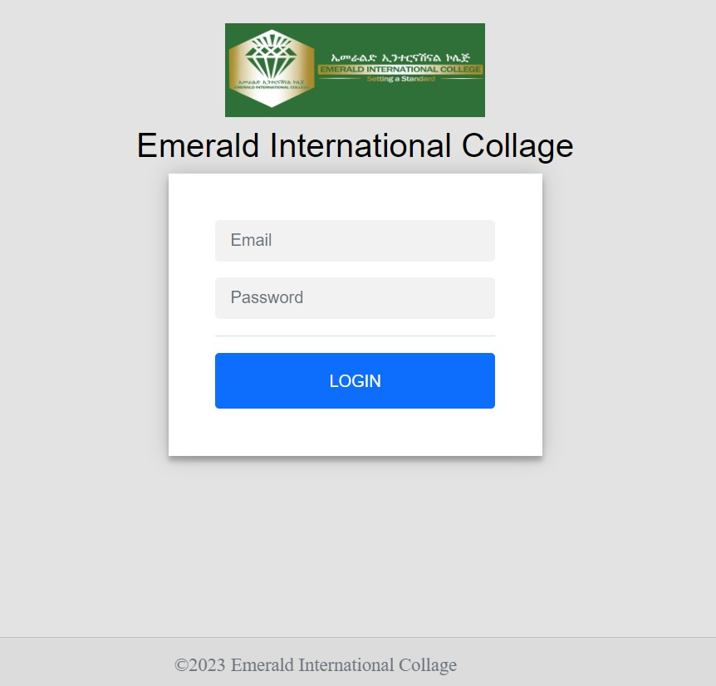

Abstract
Human Resource Management System Project is an essentially software designed to keep track of employee information in Emerald International College
The Human Resource management system project gives managers a better idea of their employees and helps them plan and manage their work hours in order to cut costs and boost productivity.
Larana, Inc.

Slide 4





Statement of problem
Slow response time
No automation
Lack of Organized data
Dissatisfaction of the user on current system
Takes long time to generate report
Data or file loss due to improper of handling

Slide 5
OBJECTIVES
General Objectives
Specific OBJECTIVE
The major goal of new system is to develop a Emeraled International College Human Resource Management System
To create fast and consistent automated system.
To secure users profile handling system.
To create efficient working environment
To create recoverable, maintainable and flexible computerized system.
To design User interfaces

Slide 6

Scope of Projects
In scope
Employee Information Management
Employee Salary Monitoring
Monitor Branch Colleges
Out scope
Employee Online Requirement
Employee Performances Appraisal

Slide 7

Sample 7
Methodology
Data Collections
The main data source for our project is the general service office. Method of data collection we use during data collection
Interview
We use interview method to gather information from different workers in different levels in the office and users of the current system.
.
Observation
to analyze the organization work processes
Document Analysis
to get information about background of the Organization.
Development methodology
We use Object oriented approach because of its more acceptable due to its greater advantage of polymorphism, abstraction, encapsulation, modularity, hierarchy, concurrency, persistence

Slide 8








Tools We Used for This project

Slide 9





Sample 5
During Implementation We used

Slide 10




Feasibilities
Technical
Economic
Operational

Slide 11


Team Configuration and Management
1
1
1
2
3
Project Manager Mr Getnet Mulat
Front End Developr Mr Girma Worku
Backend Developer Amanuel Fayisa
4
5
6
Data Base Desing &Modedilg Mr Sintayehu Workineh
UI/UX Design
Mr Wondu Wagaye
System Requirement Specification Mr Biruk Getachew

Slide 12
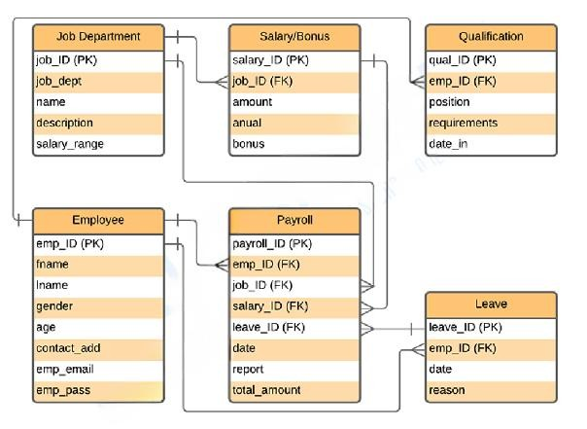
System Design
ER Diagrams
1
shows the relationships of the system’s entities that build its database design. ER diagram describes the logical structure of the system’s database or data storage. It is done by identifying the employee management process entities, their properties, and the interactions between them.
Name: | Emerald International College Human Resource Management System
Abstract: | EICHRMS ER Diagram depicts the relationship between various entities. It can be thought of as a blueprint for your system (project) structure.
Diagram: | ER Diagram (Entity-Relationship Diagram/ERD)
Users: | College or Other company
Tools Used: | Diagraming tools that provide ER diagram symbols.
Designer: | Group Member
2

Slide 13
ER Diagram Description
Table Name Employee
Table Name :Dep’t
1
Field | Description | Type | Length | Field
emp_ID (PK) | Employee ID | Int | 11 | emp_ID (PK)
Fname | Employee First Name | Varchar | 255 | fname
Lname | Employee Last Name | Varchar | 255 | lname
gender | Employee Gender | Int | 11 | gender
Age | Employee Age | Int | 11 | age
contact_add | Contact Address | Int | 11 | contact_add
emp_email | Employee Email | Varchar | 255 | emp_email
emp_pass | Employee Password | Varchar | 255 | emp_pass
Field | Description | Type | Length
job_ID (PK) | Job ID | Int | 11
job_dept | Job Department | Varchar | 30
Name | Job Name | Varchar | 30
description | Job Description | Varchar | 30
salary_range | Salary Range | Varchar | 30
Table Name :Salary/Bonus
Field | Description | Type | Length
salary_ID (PK) | Salary ID | Int | 11
job_ID (FK) | Job ID | Int | 11
amount | Amount | Int | 11
Annual | Annual Expense | Date
Bonus | Bonus | Date | bonus
Table Name :Qualifucaions
Field | Description | Type | Length
qual_ID (PK) | Qualification ID | Int | 11
emp_ID (FK) | Employee ID | Int | 11
position | Position of Application | Varchar | 30
requirements | Requirements | Varchar | 30
date_in | Date In | Date
2
Table User (Admin)
Field | Description | Type | Length
admin_ID (PK) | Admin ID | Int | 11
Fname | Instructor First Name | Varchar | 255
Lname | Instructor Last Name | Varchar | 255
gender | Instructor Gender | Int | 11
Age | Instructor Age | Int | 11
contact_add | Contact Address | Int | 11
admin_email | Admin Email | Varchar | 255
admin_pass | Admin Password | Varchar | 255
Table Name: Users

Slide 14
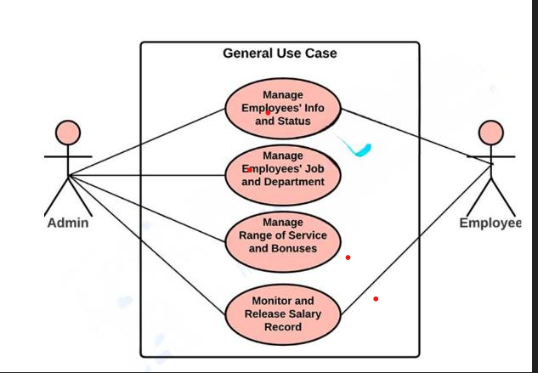
EIHRS Use Case Diagram
1
General Use Case
This diagram shows the general processes or function that the system could do that is based on the transactions done by the admin or employer in managing the their employees.
General use case is the most common application of a use case diagram. The use case
diagrams depict the system's main components as well as the flow of information
between them.
2

Slide 15
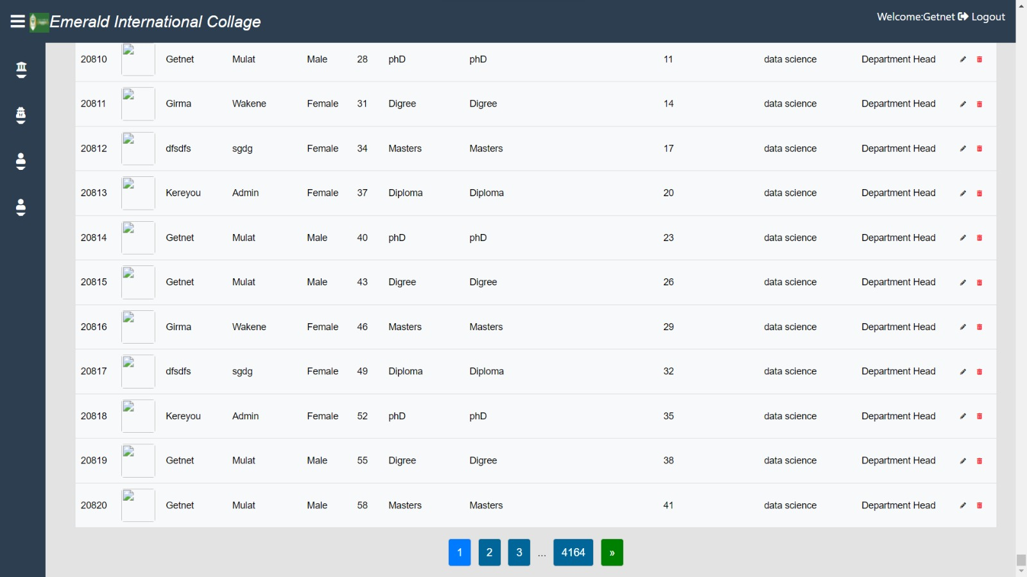
Challenges During
1
Internet Connections
The main challenges faced was lack of stable internet connection for conducting zoom meeting and other virtual meetings
Lack of Sufficient Time in the Project
2

Slide 16
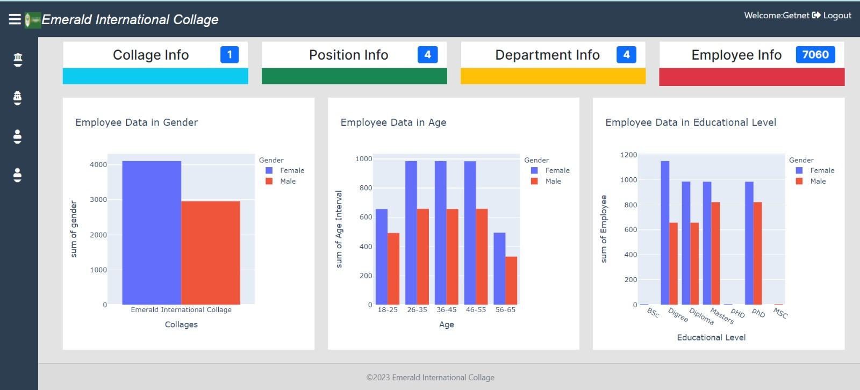

Git Hub
https://github.com/Getnetmulat/EICHRMS

